Slide 1
Basics about Rest APIs
Swati G

Slide 2
API
Application Programming Interface

Slide 3
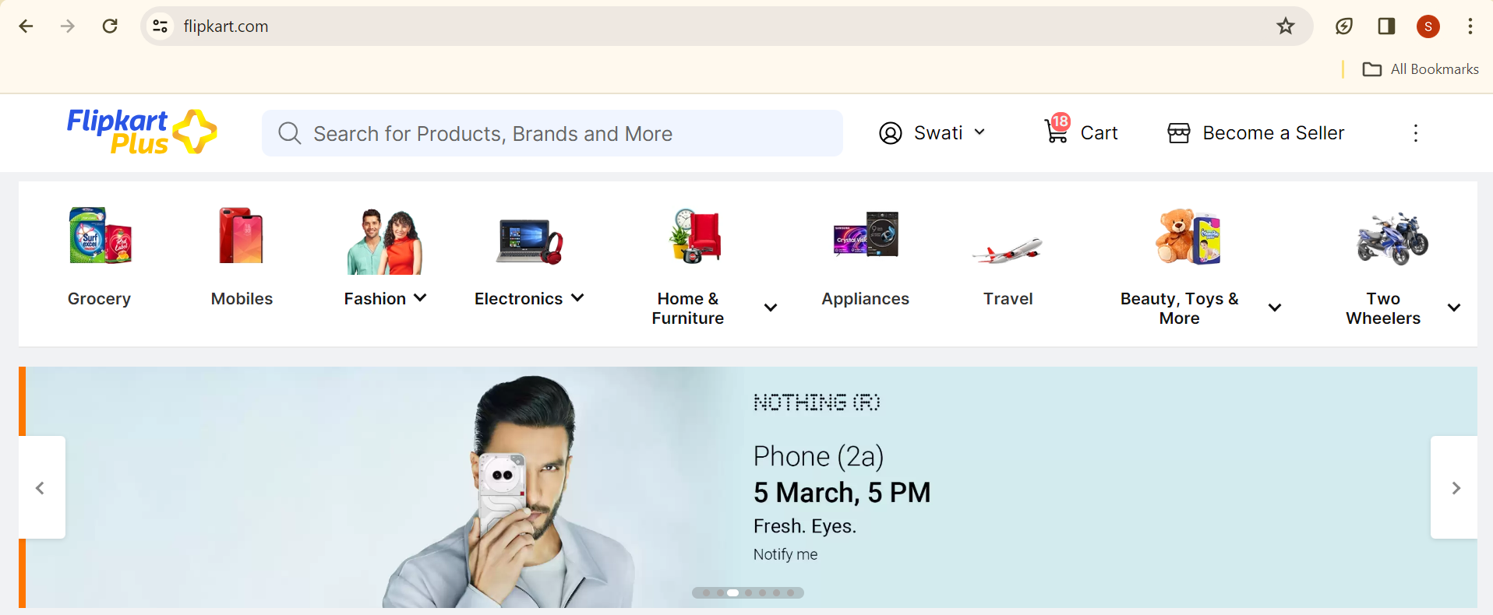
User Interface

Slide 4
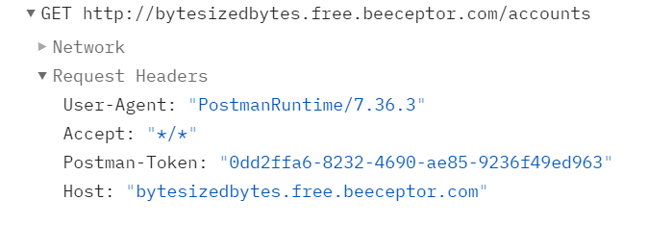
Application Interface

Slide 5
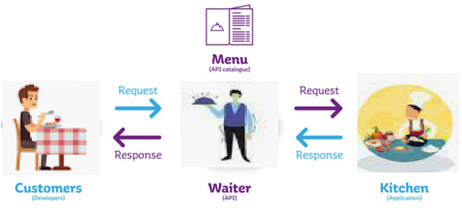
API (Application Programming Interface)
Allow interaction between two pieces of software
The party offering up its services through an API is called API provider
The one requesting/consuming its services is called the consumer
Target audience- Developers
Example: Fight Ticket Bookings

Slide 6
Why APIs?
Allow businesses to access 3rd-party data and seamlessly integrate it
Allows an application to extend the reach
Charge for accessing the data (Monetization)
Allow developers to create apps that “mash-up” data from different sources. Eg: App for the nearest Park
Mobile apps must have an API on the server to communicate with it.
Why well-designed APIs?
Satisfied Customers = Less Support Calls
Notes:
You want to create an app that shows how to get to the nearest dog park
The city provides an API that says where all the Parks are
Google Maps provides an API that says how to get to a given location
Your app calls them both!

Slide 7
Web Service
API that goes through the internet
All web services are APIs
Not all APIs are web services
Uses standard protocol over HTTP
Use XML and JSON to format data
Use SOAP and REST to transfer data

Slide 8
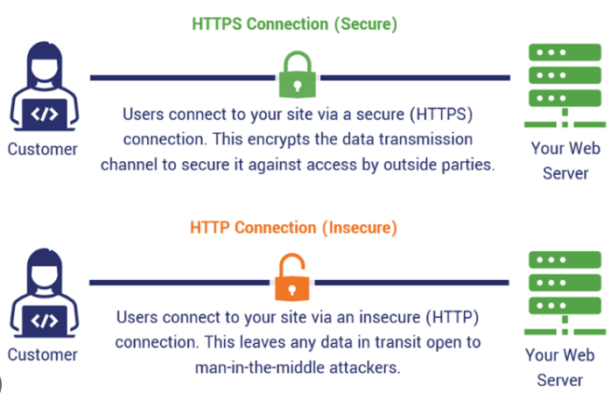
HTTPS (Hypertext Transfer Protocol)
the protocol that is used to transfer data through the Internet.
communication between client computers and Web servers is done by sending an HTTP request and receiving an HTTP response.
clients, are often browsers (Chrome, Edge etc), but they can also be any type of program or device
servers are most often computers in the cloud.

Slide 9
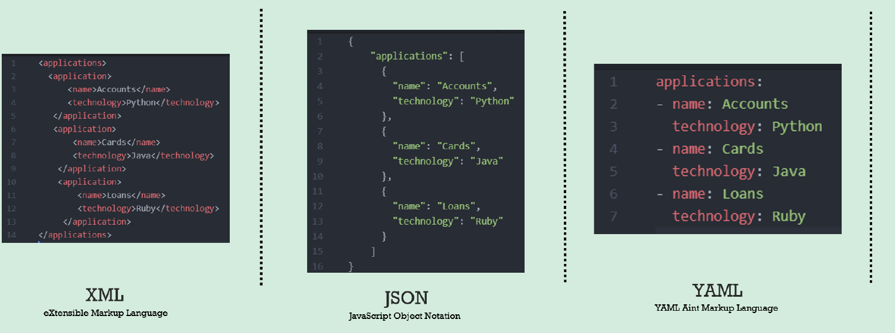
Xml vs Json vs Yaml
XML (performance issues)
Opening and closing tag
Lot of metadata rather than actual data which makes data heavy
Json (missing any syntax makes JSON invalid)
Super lightweight
Not much metadata
Syntax like double quotes, comma, colon
Key: value format
Lists: square bracket
Objects: curly bracket
Strings: double quotes
Yaml (YAML is a superset of JSON)
Super Super easy for humans to write and understand
Expects spacing and indentation
Key: value format
YAML supports comments, whereas JSON does not support writing comments inside your JSON file.
Json2yaml.com is the website that allows you to write in yaml auto converts in json and give inline feedback and does vice versa.

Slide 10
Web Service Types
SOAP
Simple Object Access Protocol
XML based
RPC style
Outdated
REST
Representational State Transfer
URL+JSON based
Defacto Standard
REST Principles
Client-server architecture
Uniform interface
Statelessness
Cacheability
Layered system
GRAPHQL
Specify the query
JSON
Notes:
Client-server architecture: REST APIs separate the client (the one requesting information) from the server (the one possessing information). The client does not have to worry about how the server stores and retrieves data. Under REST architecture, the client and server can only interact in one way: The client sends a request to the server, then the server sends a response back to the client. Servers cannot make requests and clients cannot respond — all interactions are initiated by the client.
Uniform interface: Whether the client is a software application, a browser, a mobile app, or something else entirely, it can access and use the REST API in the same way.
Statelessness: The server does not have to remember the client’s state. All the client’s requests must be “stateless,” so each request must include all necessary information (such as the client’s authentication details). This means that every interaction is independent, and each request and response provides all the information required to complete the interaction
Cacheability: REST servers can cache data and reuse it for other requests in the future. Caching occurs when media is stored on a client’s device when visiting a website. When a client returns to that site, the cached data is loaded quickly from local storage instead of being fetched again from the server. Caching saves server resources and bandwidth while decreasing page load time, which is why most large websites do it.
REST APIs are created with data caching in mind. When a server sends its response to a client, the response should indicate whether the resource provided can be cached, and for how long.
Layered system: REST APIs may have multiple intermediary layers between the client and the server. However, the client does not have to know these implementation details. ’we have described API requests as a simple interaction between a client and server, but this is a bit of a simplification. In reality, there are typically more servers between these two entities. These servers, or layers, are there to add security, handle and distribute traffic, or assist with a number of other important functions. This principle requires that messages between the client and target server should always be formatted and processed the same way, regardless of layers that sit between them.
Code on demand (optional): Clients may download code (e.g. Java applets or JavaScript scripts) to access additional functionality at runtime.
https://www.integrate.io/blog/why-you-need-a-rest-api/

Slide 11
Rest API
Simple to implement
compatible with a variety of messaging formats, including XML, YAML, and JSON
Defacto standard
Major websites expose this
Developers expect it
Supported by all platforms (dotnet, JAVA, PHP etc)

Slide 12
API Types
Private APIs
to put wrapper- Internal APIs are proprietary, used by and within a single organization to more safely manage its own data.
These enable businesses to ‘wrap’ or integrate with aging technology that they may eventually replace; to future-proof new front-end development or new capabilities that depend on existing technology. Eg: When the existing system is a monolith or has limitations — which is likely to be the reason the organization is pursuing a wrapper.
Public APIs
These enable businesses to expose their capabilities to other businesses or consumers. For example, an API that allows external re-sellers to search for products or place orders for products through a programmatic interface. Public APIs are the most relevant for open data banking. These are the platforms that allow TPPs to access consumer data from a bank without actually saving and storing it.
Partner
Partner or B2B APIs are designed for two or more specific businesses and allow for the ready exchange of enterprise data. The applications are particularly effective for vendor-to-vendor communications, enterprise resource planning, and producer-retailer-reseller relationships

Slide 13
Structure of REST API
Structure of REST API Request
URL→ Location of the resource
Method→ HTTP verb
Headers→ Metadata about API
Body→ Content of the request
Structure of REST API Response
Status Code→ Three Digit number
Headers→ Metadata about response
Response Body→ Content of the response

Slide 14
URL

Slide 15
METHODS
GET
Retrieve resource
Eg: Fetching account details
Default verb of the browser’s address
Usually combined with parameters
Too many parameters use POST
IDEMPOTENT
POST
create a resource
Eg: Open an account
Should contain the message body that specifies the resource to be added
Should not contain query
NOT IDEMPOTENT
PUT
Modify resource
Eg: Update Account address
Should contain a message body
Should not contain query
IDEMPOTENT
DELETE
Delete resource
Eg.: Delete the mobile number from the account
Always combined with parameters
Should not contain the body of the request
IDEMPOTENT
A resource can be any information that can be named. Eg: a person, or an invoice can be resource
Notes:
Idempotency- producing the same results by invoking even multiple times. POST is not idempotent

Slide 16
Request Header

Slide 17
Request Body

Slide 18
REST API Common Http Status Codes
2…
Healthy responses
200: OK
201: CREATED
202: ACCEPTED
3…
Redirect responses
301- Moved Permanently
302- Found
4…
Client responses
400 Bad Request (malformed API keys or Invalid payload)
401 Unauthorized (missing API keys)
403- Forbidden (don’t have access)
404- Not Found
405- Method Not Allowed
5…
Server Responses
500 – Internal Server Error
501- Time Out

Slide 19
Response Header

Slide 20
Body Response

Slide 21
Rest API Principles
API has clear messaging, defining the purpose of each API domain, and is written in such a way that a non-programmer can understand what this API publishes. The intent is clear and understandable from a business perspective
Depict Resource Hierarchy Through URI. Forward slash separator (/) must be used to indicate a hierarchical relationship.
Sub-resource collections should exist directly beneath an individual resource to convey a relationship to another collection of resources.
Aim to restrict the nesting of resources to a maximum of three levels.
Hyphens (-) should be used to improve the readability of URIs.
Literals/expressions in query strings should be separated using underscore( _ ).
URIs should start with a letter and use only lowercase letters. camelCase (Lowercase first letter of first word, capitalizing the first letter of subsequent words) is the most common naming convention for defining attributes.
Resource names should be nouns instead of verbs. CRUD function names should not be used in URIs.
Avoid using singular nouns to describe a resource, always use plural nouns.
Use Filtering, Sorting, and Pagination to retrieve the data requested.
Handle errors gracefully and return standard error codes
Use query parameters for advanced filtering & searching
Notes:
Outside of the e-commerce world, we can see good examples of business-focused public APIs and branding from Lyft and Sabre; the completely API-driven business empire created by Twilio; and an evolving vision of APIs from Mercedes Benz. It’s instructive to look at the shapes and the core features of these APIs because they reflect the core business capabilities and visions of their companies.

Slide 22
Versioning

Slide 23
Swiggy
Restaurant Listing Service
Notes:
System Design architecture for food delivery services like Swiggy, Zomato or UberEats – UpVey

